Slide 1
Research Plan and Initial Results
FEHU Task 2: Human Value Recognition in Subevents
Exploring Selective Use of Article Context
Liu Dongyang 2026/10/15
Data Engineering Lab, IPS, Waseda Univ.

Slide 2
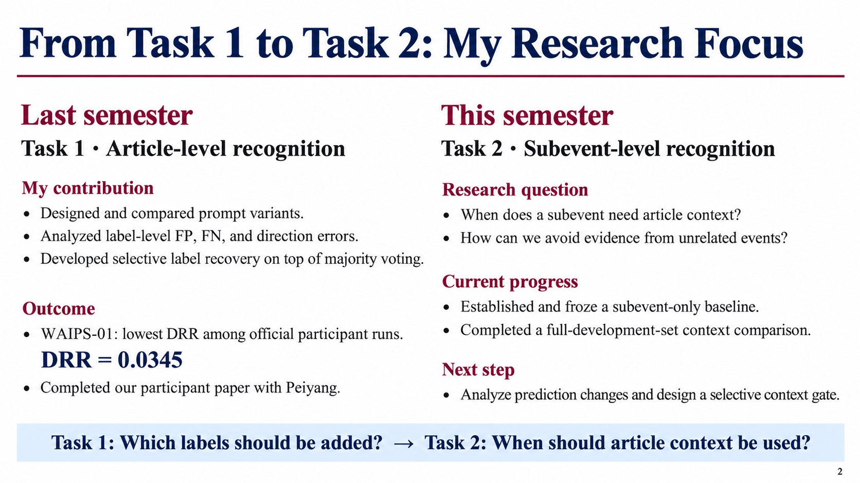
My Previous Work and Current Focus
Last semester: Task 1
This semester: Task 2
◆ Collaborated with Peiyang on our participant paper.
◆ Continue collaborating with Peiyang.
◆ Prompt design and label-level error analysis.
◆ Study when subevent predictions need article context.
◆ Conservative voting + selective label recovery.
Focus: use broader context while keeping predictions specific to the current subevent.
2

Slide 3
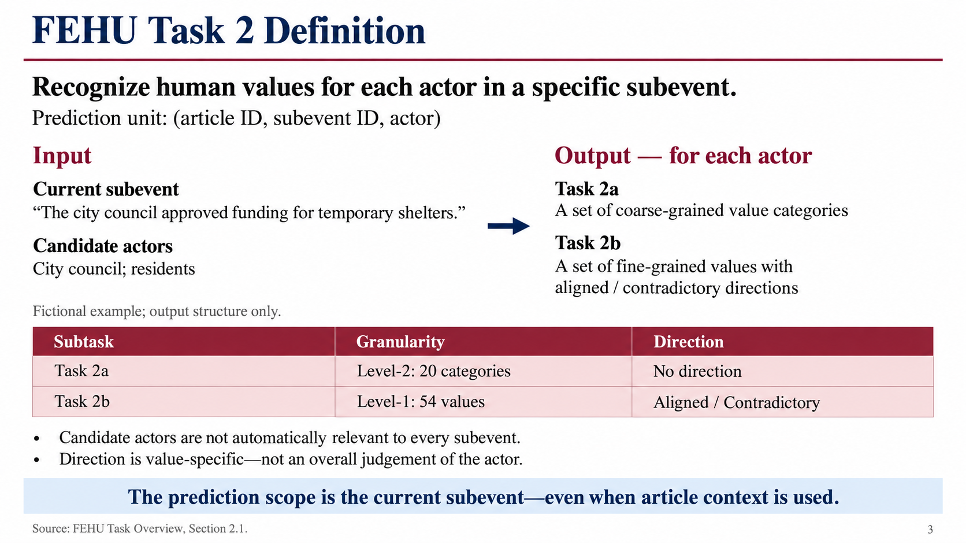
FEHU Task 2 Definition
Prediction unit: (article, subevent, actor)
Subtask | Value labels | Direction
Task 2a | 20 Level-2 categories | Not required
Task 2b | 54 Level-1 values | Aligned / Contradictory
◆ The article-level actor list provides candidates; not all participate in every subevent.
Direction concerns an actor’s conduct, speech, position, or outcome—not a general moral judgement.
Source: FEHU Task Overview, Section 2.1.
3

Slide 4
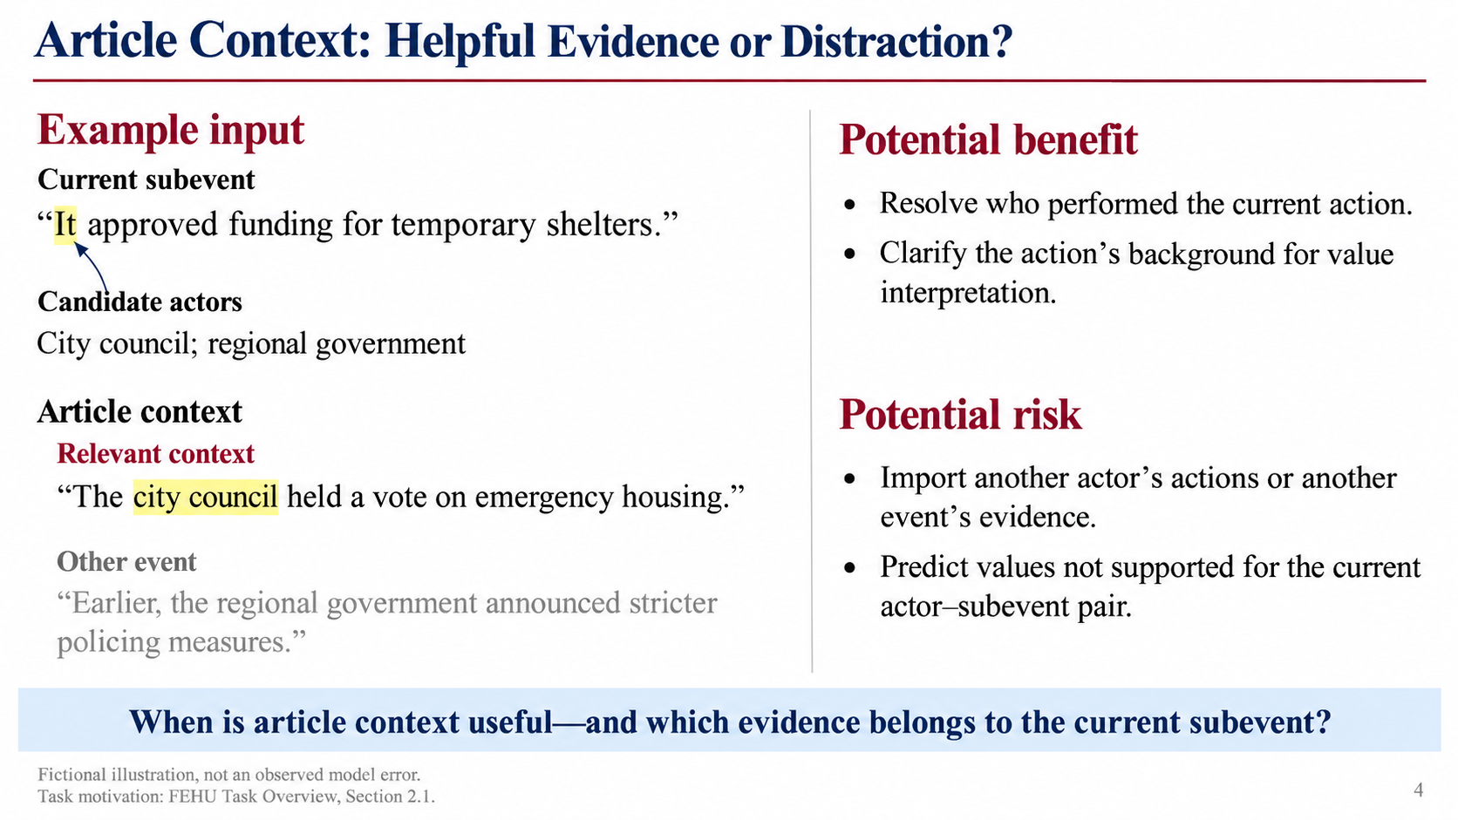
Why Local Evidence May Need Context
Fictional example
Article context
Who does “it” refer to?
“The city council announced an
emergency support program.”
Context may clarify the actor
and purpose of an action.
Output must still concern
the current subevent.
Current subevent
“It approved funding for
temporary shelters.”
Illustration only; no experimental labels. Motivation: Task Overview, Section 2.1.
4

Slide 5
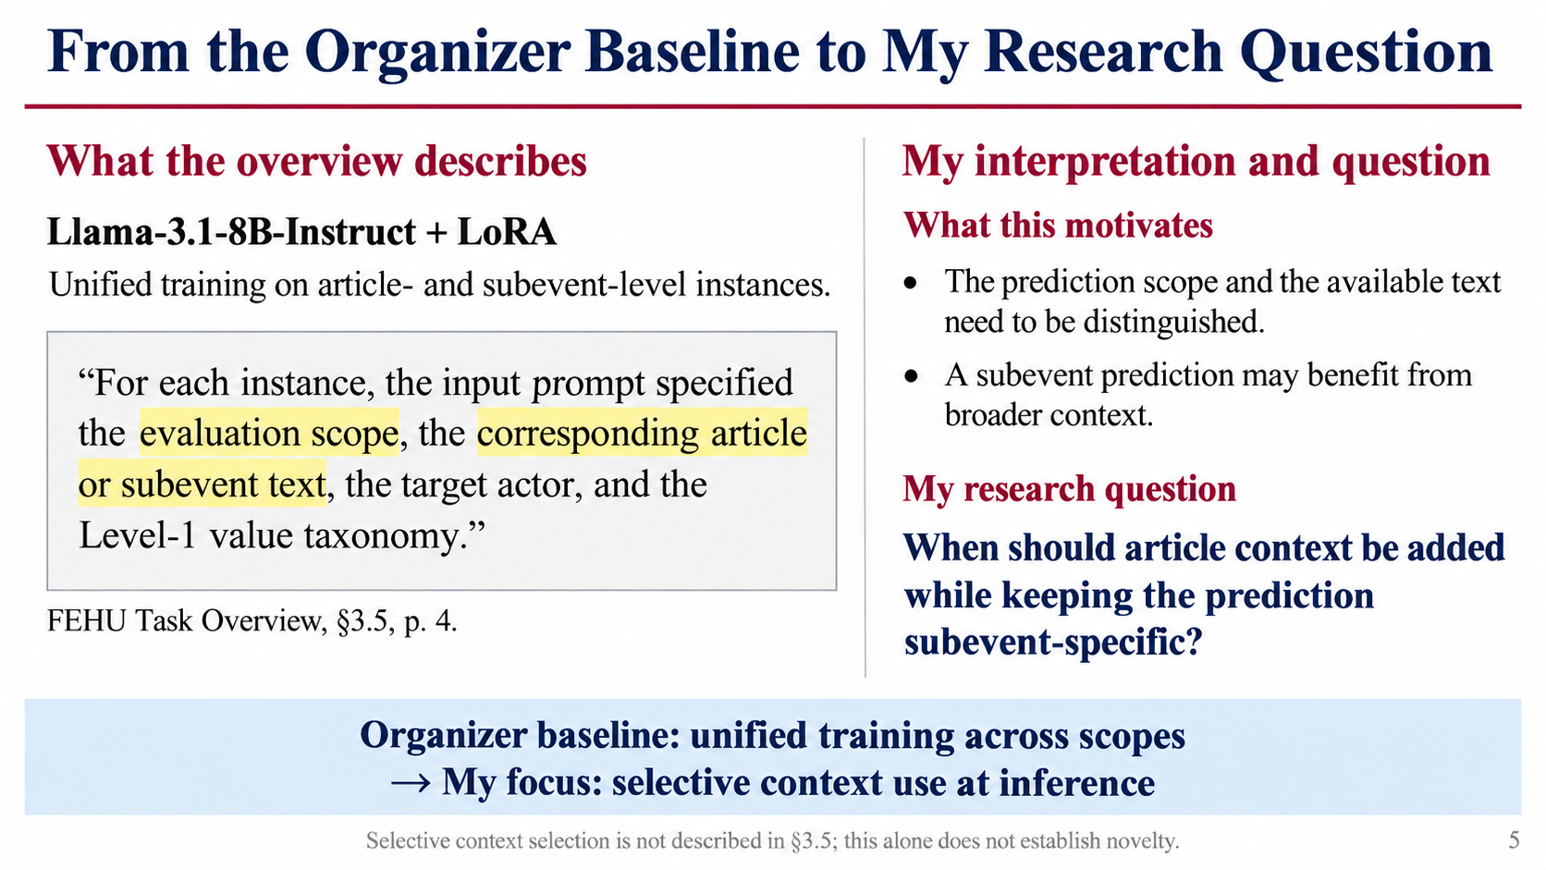
The Organizer Baseline and My Question
Organizer baseline
My research question
◆ Llama-3.1-8B-Instruct + LoRA.
◆ One model trained on article and subevent instances.
When should subevent
inference use
article context?
◆ Input: scope-specific text, actor, Level-1 taxonomy.
◆ Level-2 output: deterministic mapping.
Task Overview §3.5 does not describe a selective context gate. This is not a fine-tuning replication.
5

Slide 6
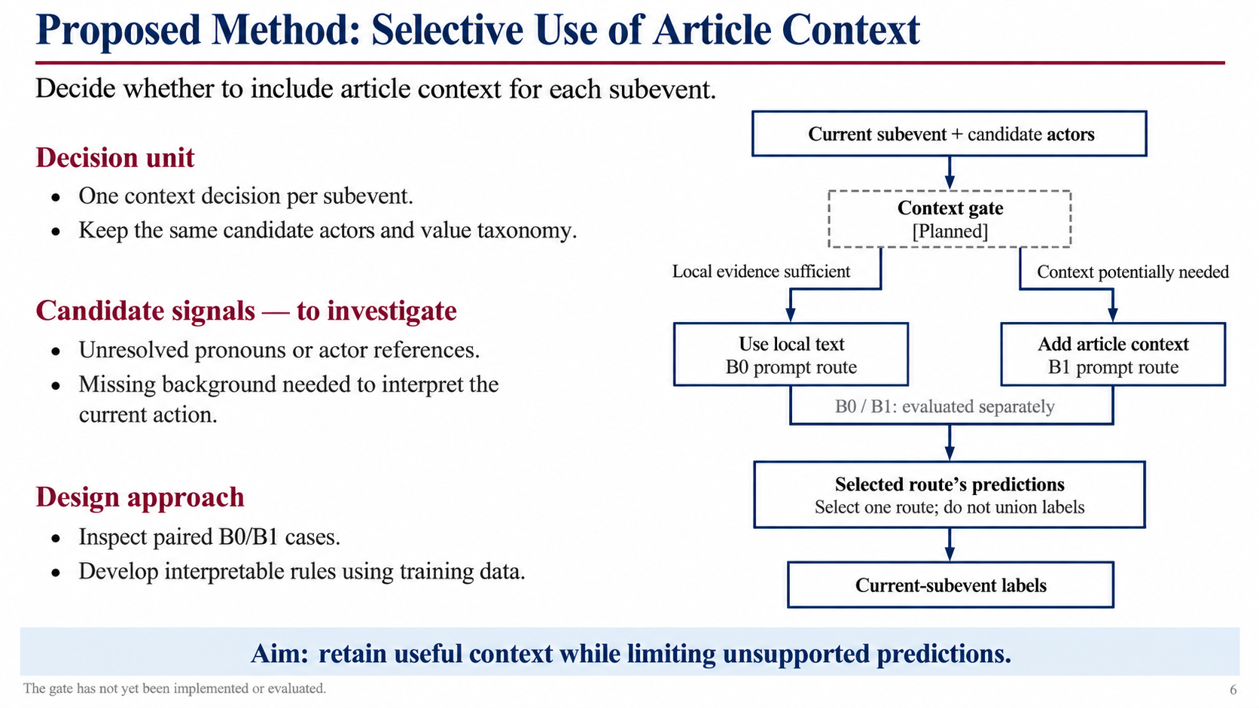
Proposed Research Direction
Current subevent
◆ Use local evidence when sufficient.
↓
Context decision (Planned)
◆ Add context when actor identity or references are unclear.
↙ ↘
Subevent only
Subevent + article
◆ Keep output tied to the current subevent.
↘ ↙
Current-subevent labels
Proposal only: the context-selection gate has not been implemented.
6

Slide 7
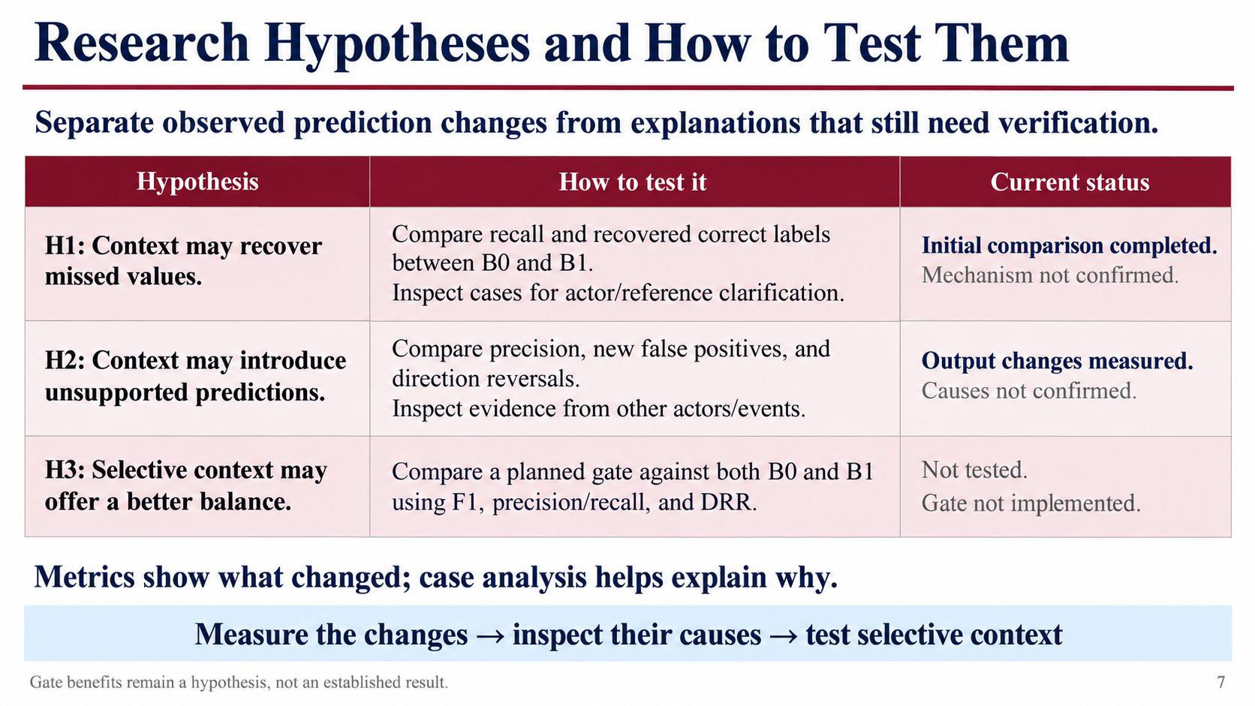
Research Hypotheses
H1: Context can recover missing labels
Article context may clarify actors and references.
H2: Context can introduce extra errors
Other events may influence the current prediction.
H3: Selective context may improve the trade-off
A gate may retain useful context while limiting interference.
H1/H2 mechanisms need case analysis. H3 remains untested.
7

Slide 8
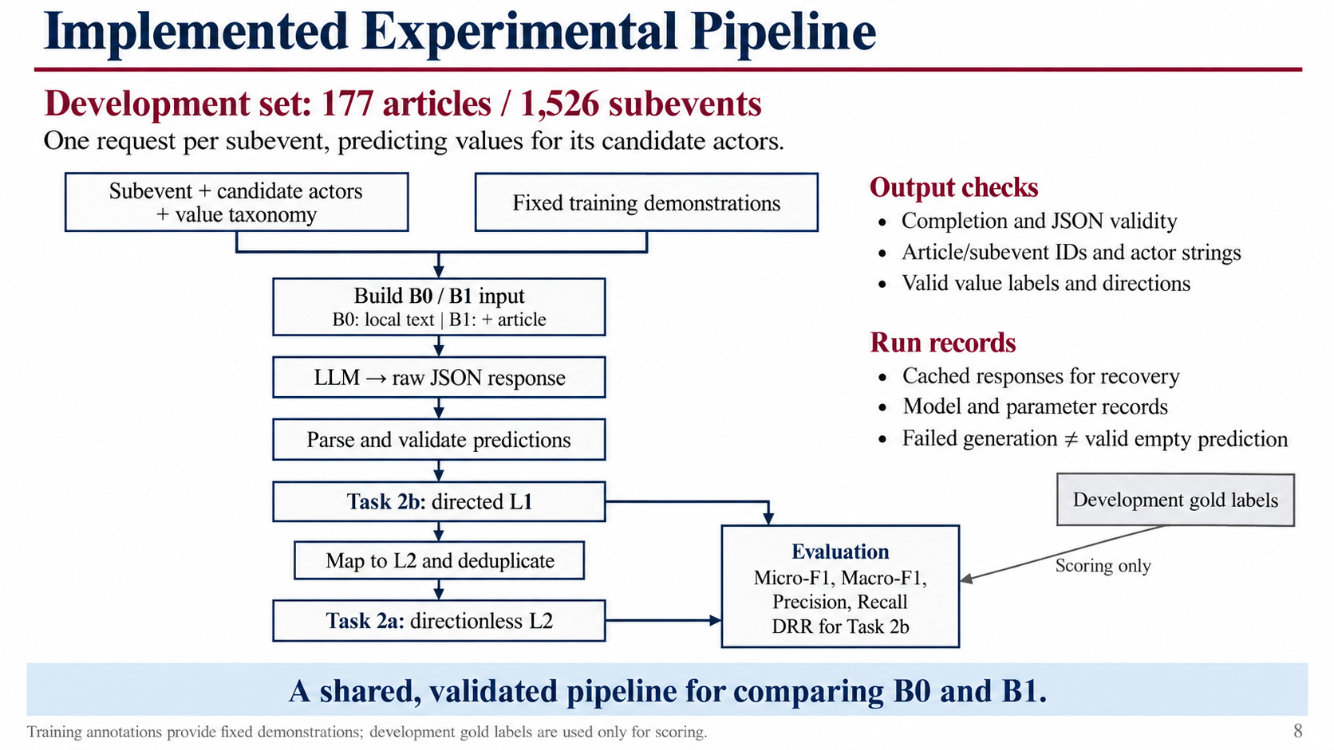
Experimental Workflow
Development set: 177 articles / 1,526 subevents
1. Build the input prompt
2. Request Task 2b predictions
3. Check completion, JSON structure, and valid IDs
4. Map Level-1 predictions to Task 2a labels
5. Score both outputs with the evaluator working copy
Gold labels enter evaluation only; cached recovery and output validation are implemented.
8

Slide 9
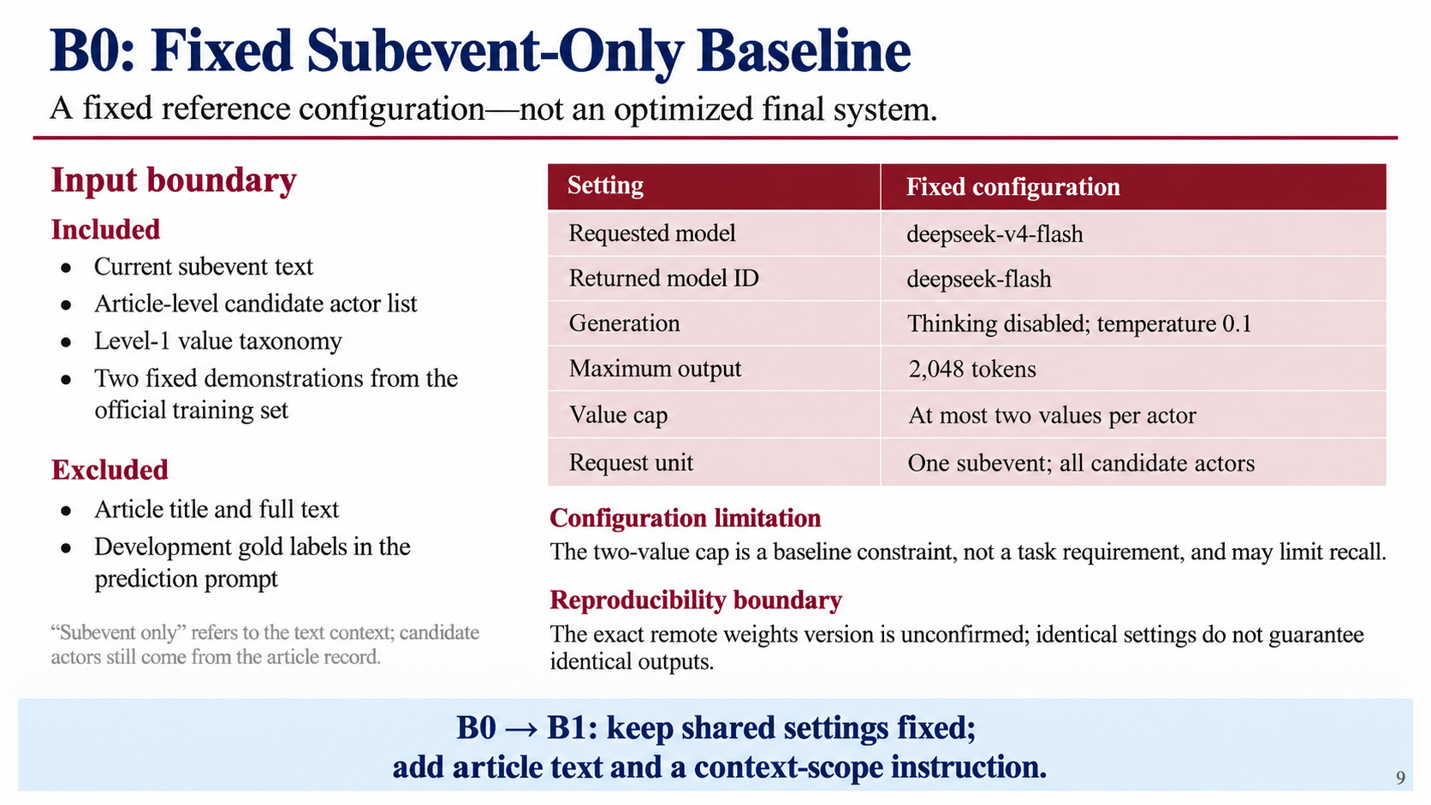
Frozen Baseline B0
Input: subevent + candidate actors + Level-1 taxonomy
Setting | Fixed configuration
Prompt | Two official-training demonstrations
Generation | Thinking disabled; temperature 0.1
Output budget | 2,048 tokens
Label limit | At most two values per actor
Prediction | All candidate actors in one request
Requested: deepseek-v4-flash | Response identifier: deepseek-flash
Exact remote weights version remains unconfirmed.
9

Slide 10
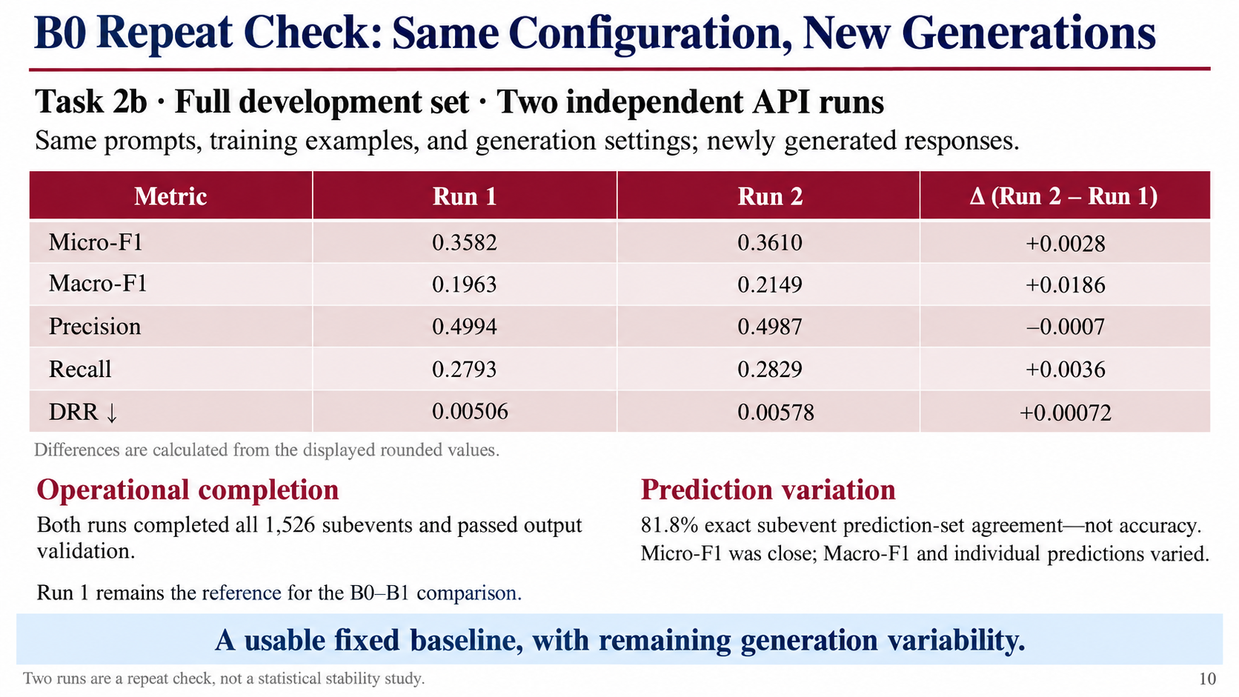
Independent Baseline Repeat
Task 2b • Complete development set
Metric | Run 1 | Independent repeat
Micro-F1 | 0.3582 | 0.3610
Macro-F1 | 0.1963 | 0.2149
Precision | 0.4994 | 0.4987
Recall | 0.2793 | 0.2829
DRR ↓ | 0.00506 | 0.00578
All 1,526 subevents completed and passed validation in both runs.
Micro-F1 difference: 0.0028; identical subevent predictions: 81.8%.
Operationally verified, not deterministic: Macro-F1 and individual predictions still vary.
10

Slide 11
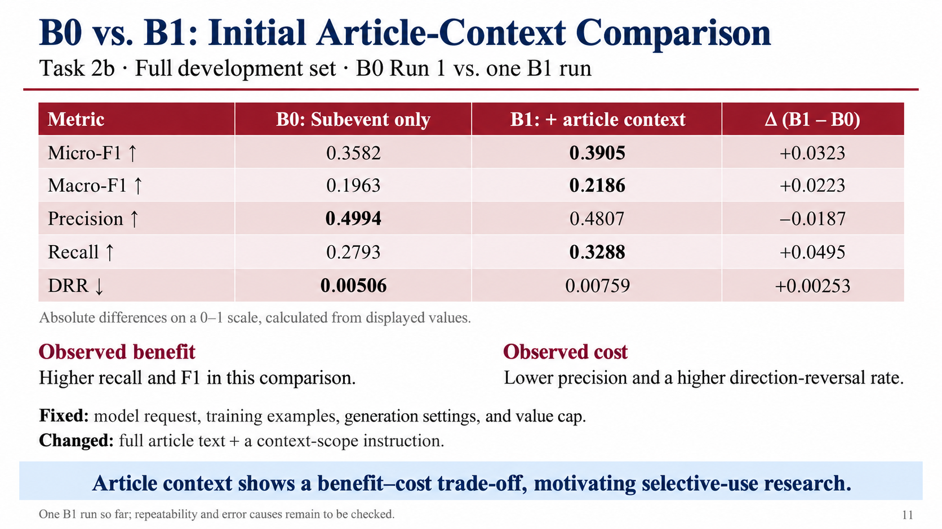
Article Context Comparison
Task 2b • Complete development set
Metric | B0: Subevent only | B1: + article
Micro-F1 | 0.3582 | 0.3905
Macro-F1 | 0.1963 | 0.2186
Precision | 0.4994 | 0.4807
Recall | 0.2793 | 0.3288
DRR ↓ | 0.00506 | 0.00759
Higher recall and F1, but lower precision and more reversals.
Same generation settings/examples. B1 adds article + scope instruction; one B1 run so far.
11

Slide 12
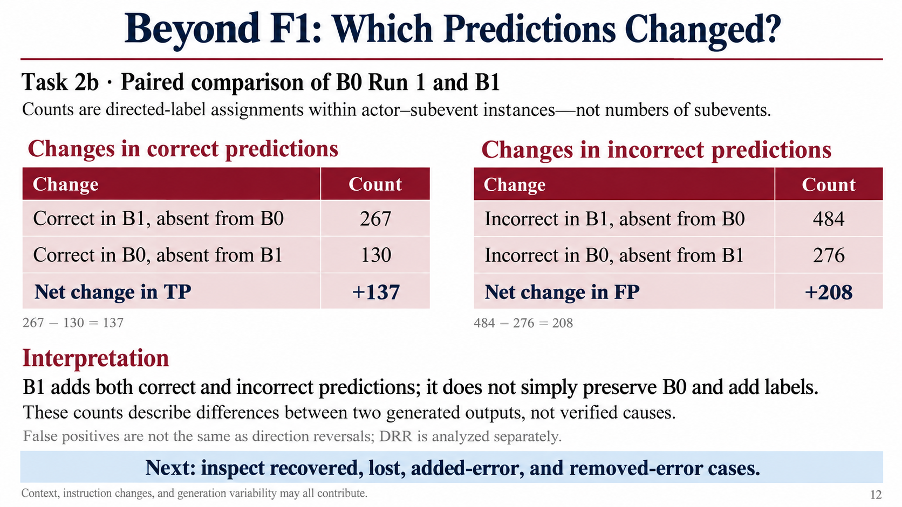
What Changes with Article Context?
Task 2b • Directed-label changes: B0 → B1
Change | Number of directed labels
Correct labels recovered by B1 | 267
Correct B0 labels lost in B1 | 130
New false positives in B1 | 484
B0 false positives removed by B1 | 276
Net: 137 more correct labels / 208 more false positives
Output changes do not establish their causes; case analysis is still needed.
12

Slide 13
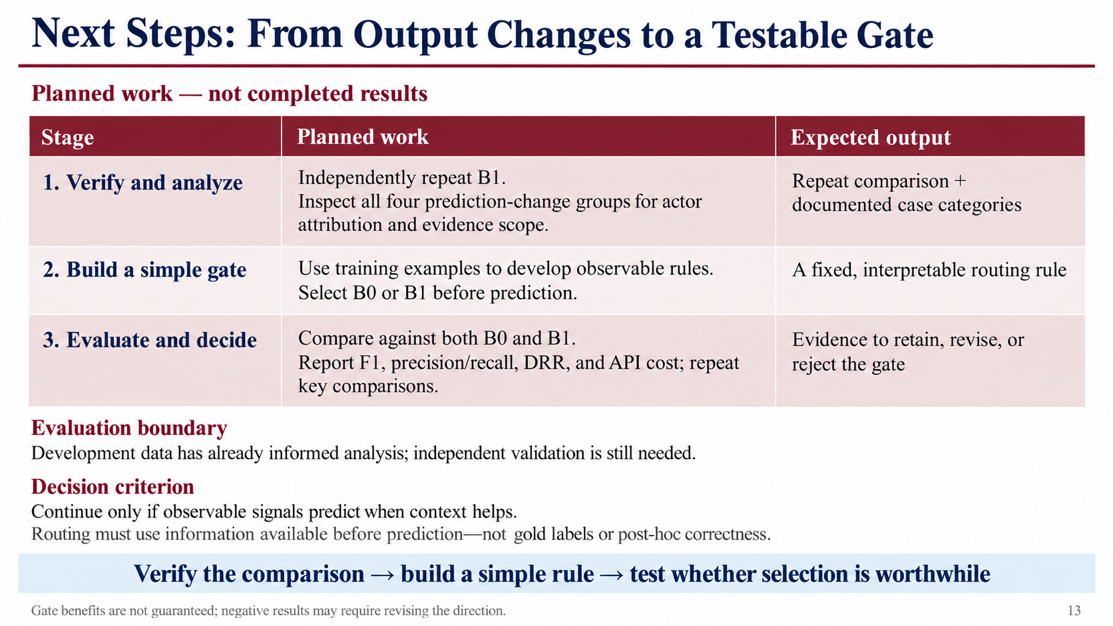
Next Research Stage
1. Case analysis
Inspect actor attribution and evidence for recovered/lost labels.
Check possible influence from unrelated events.
2. Gate design (Planned)
Develop interpretable conditions using training data.
Decide when a subevent needs article context.
3. Evaluation
Compare against frozen B0/B1: F1, direction errors, API cost.
Repeat key comparisons where necessary.
13

Slide 14
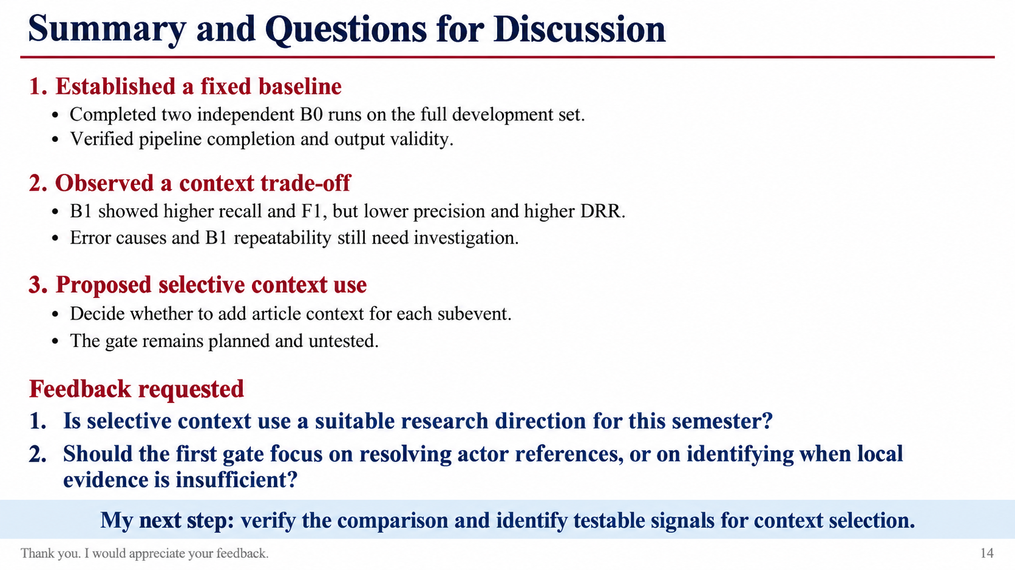
Progress and Questions for Discussion
Completed
Frozen baseline + full development-set context comparison
Proposed direction
Selective article context for actor-specific subevent predictions
Questions for discussion
◆ Is this a suitable research focus for this semester?
◆ Should I prioritize actor references or evidence-scope control?
◆ How can Peiyang and I define complementary roles?
14

